Slide 1
Waitakere BMX Club 2.4 (Practice task)
(Your name)

Slide 2
Relevant Implication
Usability
Usability is the ease of use of a website. To make my website easy for the end user to use and adhere to the current standards, I will have a sticky navbar that will sit at the top of the page to allow the user easy access to the rest of the site. My nav will have an active class to identify the current page to the user as well as a hover effect to give the user feedback when they hover over the hyperlinks.
Important information such as the originations name will and logo will be placed in the top left in the navbar so that it is almost always visible. The footer will contain hyperlinks to various pages as well as a copyright statement.
Notes:
Identify and explain 3 relevant implications that you will focus on during the creation of your project

Slide 3
Relevant Implication
Aesthetics
Aesthetics is the visual look and quality of a website. To make my website modern and aesthetically pleasing I will ensure that it adheres to current web design standards. To make the website catch the users eye and attention I will use an appropriate colour palette and fonts.
Notes:
Identify and explain 3 relevant implications that you will focus on during the creation of your project

Slide 4
Relevant Implication
Copyright
Copyright is the protection of creative work that gives the owner exclusive rights to his or her work and is governed under the copyright act 1994.
When sourcing images and media for the website I will adhere to all copyright laws. I will do this by filtering my search for the appropriate copyright licence and use sites like pixabay to source copyright right/royalty free photos.
Notes:
Identify and explain 3 relevant implications that you will focus on during the creation of your project

Slide 5
Step 1 : Empathize

Slide 6
Task 1 : Identify your client and the purpose of your website, who is your target audience?
The client I will be developing a website for is Waitakere BMX Club, I have been asked by the president to design a new, modern looking site that will attract more users to site to promote the club.
The target audience of this site is the local community, other BMX riders from around New Zealand.
Aged from 5 – 50.
Notes:
Check out their current site so you can see why they want a new design
https://www.waitakerebmx.com/

Slide 7
Step 2 : Define

Slide 8
What are your client’s specifications?
The site must be modern
Clean and simple layout
Use of bright colours
Professional looking
Promote the club
4 pages
Image slider on the home page showing recent photographs

Slide 9
Website Structure
index.html
our-track.html
gallery.html
results.html

Slide 10
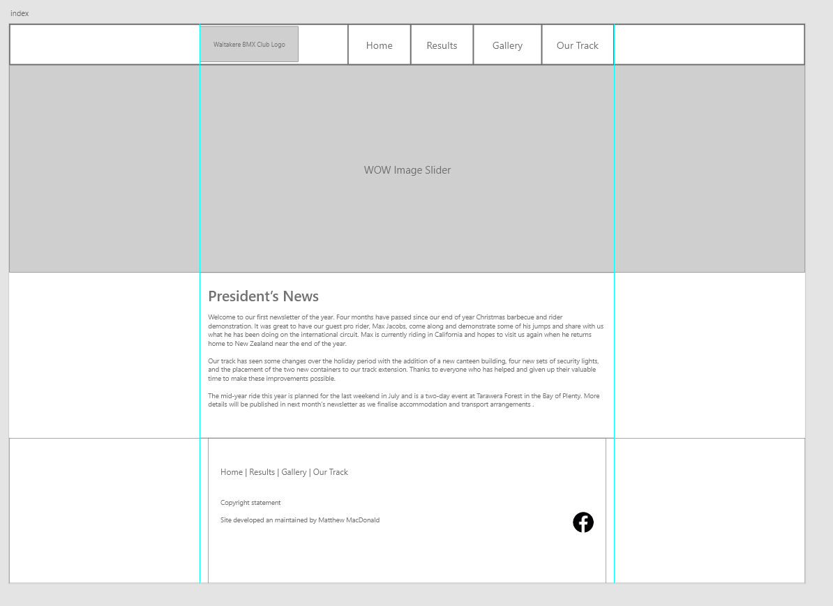
Low fidelity mock up of the home page

Slide 11
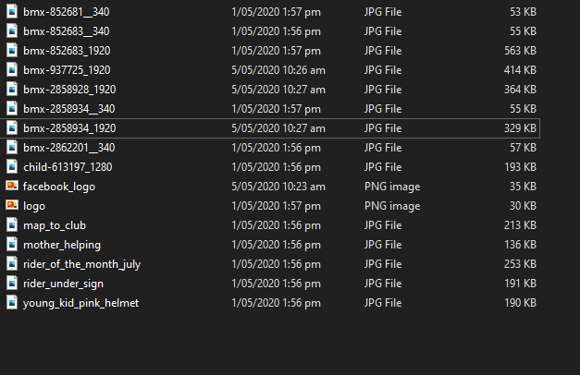
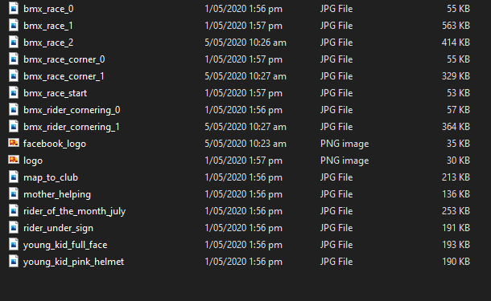
Image compression
Notes:
Save images to an appropriate name folder
Compress / edit images where need be
Name the files accurately e.g home_mainimage.jpeg suzanne_collins_closeup.jpeg rather than 249784sflkjfnjksfxn3r8.jpeg
Record this process

Slide 12
Step 3 : Ideate

Slide 13
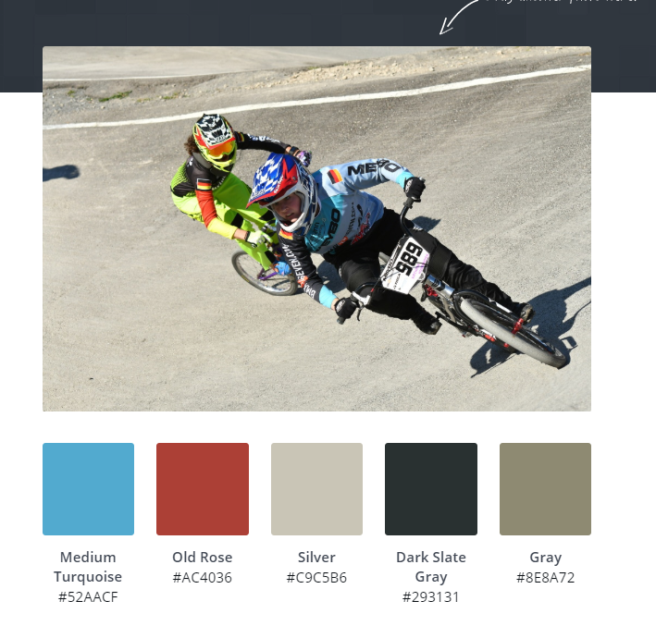
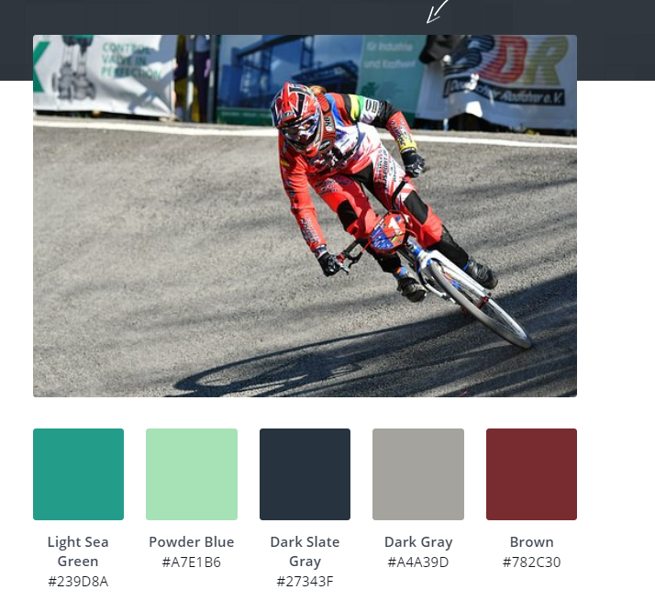
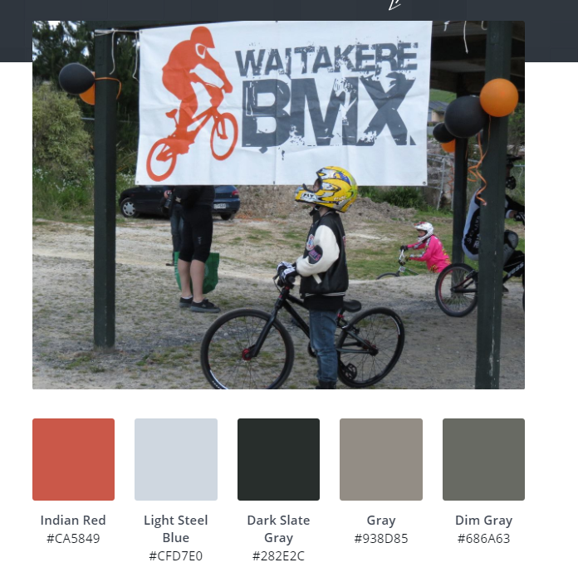
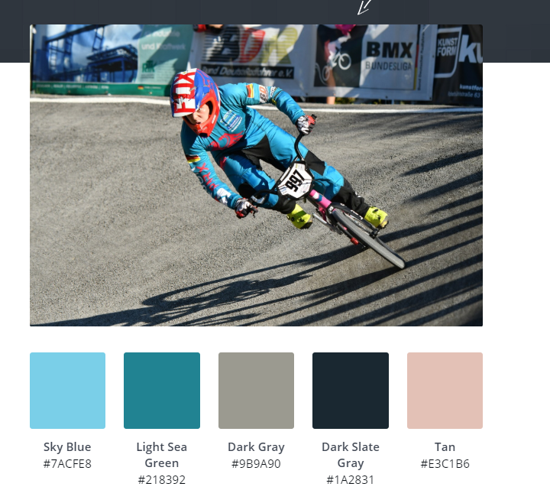
Colour palette
Notes:
Generate 3 colour options for your client, keeping in mind he wants a clean layout (white background with a pop of colour)
https://www.canva.com/learn/100-color-combinations/

Slide 14
Font Combinations
Notes:
https://howtogetonline.com/best-google-font-combinations-currently-trending.php
Select 3 different font options that you wish to present to your client and trial when you are coding

Slide 15
Step 4 : Protype/ Testing

Slide 16
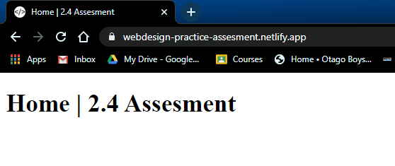
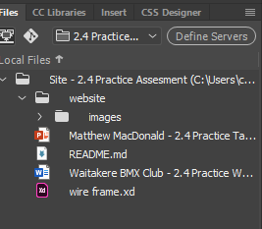
Site setup
https://webdesign-practice-assesment.netlify.app/
Notes:
Screenshot your folder in Dreamweaver showing that your files are named correctly(lower case and underscores)

Slide 17
A vs B testing (colours)
Notes:
Trial

Slide 18
A vs B testing (fonts)
Notes:
Trial

Slide 19
Feedback from client / stakeholders
Notes:
Screenshot your home page and seek written feedback from end users
What changes do you need to make and why? Do you need to carry out further research or give more colour/font options etc/

Slide 20
Cross browser testing
Notes:
Test your site on mobile, tablet and pc view AND in different browsers

Slide 21
Testing Procedures: Validating the HTML/CSS
Notes:
Validate your HTML/CSS3 website – screenshot the no errors.

Slide 22
Explain how your final design addressed the relevant implications

Slide 23
Addressing relevant implication : Usability
S
E
X
A
A relevant implication that I focussed on during the creation of my website was usability. Usability is the process of making my site easy for my end users to navigate. I wanted to present my information and photography in a minimalistic way so that a wide range of people could access my site. For example, I made sure that I used the colour ??? For my hover effect on my main navigation bar, this gave clear contrast allowing users to instantly recognize their location on the nav bar. Furthermore, I had a footer with secondary hyperlinks so that the user wouldn’t have to scroll to the top unnecessarily. When trialling my site, some of my end users thought that my font in the nav bar was too small, therefore I changed the font to 120% to make it easier to read, especially for people who wear glasses etc. My target audience is young people to older people across NZ who have an interest in BMX. My site also uses media queries to ensure that it scales across different devices so that it can be accessed on phones and different monitor sizes.

Slide 24
Addressing relevant implication :

